Slide 1
μ741 : Integrated Operational Amplifier − Operation Overview
John K. Zao, jkzao@cs.nctu.edu.tw
2012/11/20

Slide 2
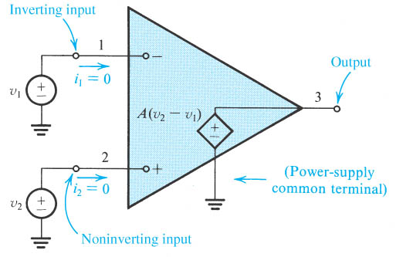
Ideal Circuit Model
Figure 2.3 Equivalent circuit of the ideal op amp.
Notes:
sedr42021_0203.jpg

Slide 3
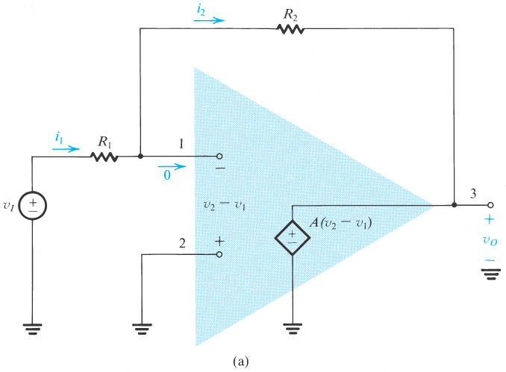
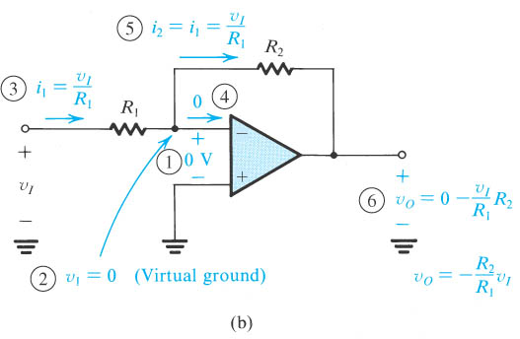
Negative Feedback : Inverting Amplifier
Figure 2.6 Analysis of the inverting configuration. The circled numbers indicate the order of the analysis steps.
Notes:
sedr42021_0206a.jpg

Slide 4
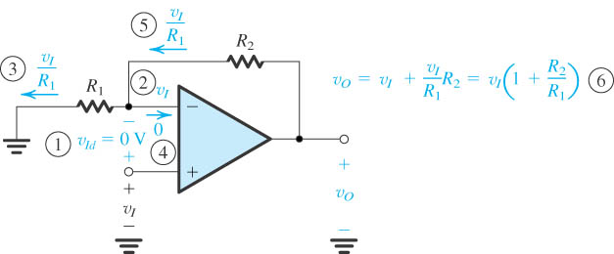
Non-inverting Amplifier
Figure 2.13 Analysis of the noninverting circuit. The sequence of the steps in the analysis is indicated by the circled numbers.
Notes:
sedr42021_0213.jpg

Slide 5
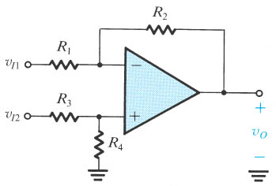
Difference Amplifier
Figure 2.16 A difference amplifier.
Notes:
sedr42021_0216.jpg

Slide 6
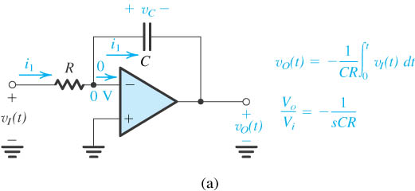
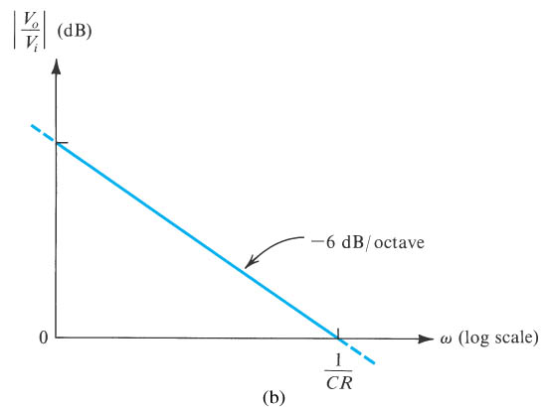
Miller Integrator
Figure 2.39 (a) The Miller or inverting integrator. (b) Frequency response of the integrator.
Notes:
sedr42021_0239a.jpg

Slide 7
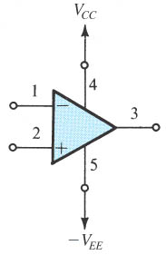
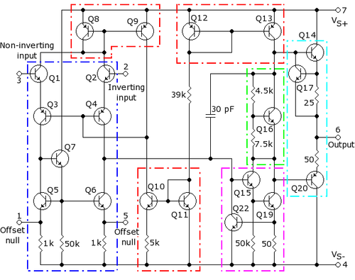
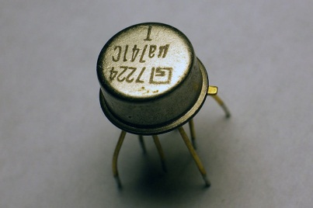
Schematics

Slide 8
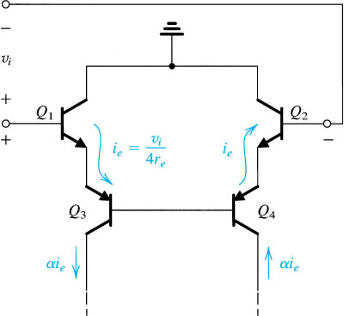
Differential Input Stage
Figure 9.19 Small-signal analysis of the 741 input stage.
Notes:
sedr42021_0919.jpg

Slide 9
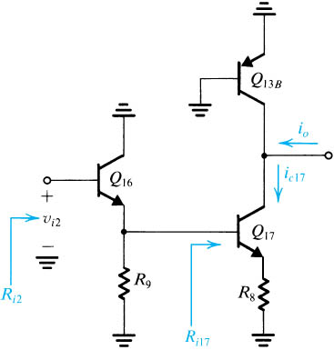
Voltage Amplification Stage
Figure 9.24 The 741 second stage prepared for small-signal analysis.
Notes:
sedr42021_0924.jpg

Slide 10
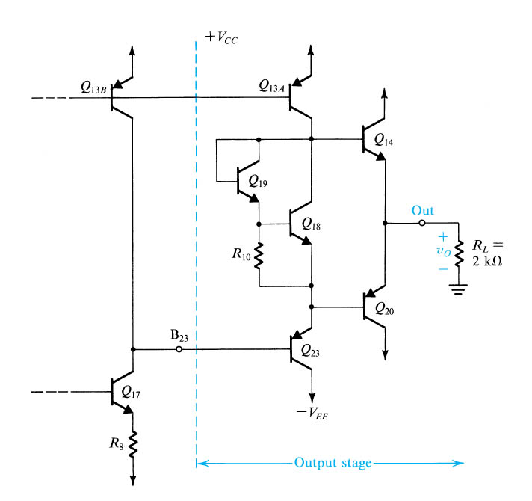
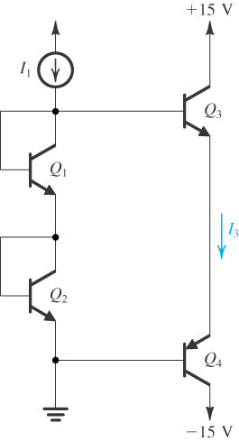
Output Stage
Figure E9.10
Figure 9.28 The 741 output stage.
Notes:
sedr42021_e0910.jpg

